Slide 1
Weed Count Overview ACRES – Summer 2022
VARUN AGGARWAL
Project Supervision:
Dr. Dharmendra Saraswat | Dr. Bryan YouNG

Slide 2
Overview
Weed Species | Corn | Soy
IPOSS = Morning Glory spp. | X | X
CHEAL = Common Lambsquarters | X | X
SIDSP = Prickly Sida | X | X
ABUTH = Velvetleaf | X | X
SETFA = Gaint Foxtail |  | X
ERICA = Horseweed | X
RANAB = Smallflower buttercup | X
SICAN = Burcucumber | X
CYPES = Yellow nutsedge | X
POROL = Common purslane |  | X
UAS flights at 3 – 4.5 m
Corn in V2/3 and V5/6 Growth Stage
Soy in VC and V2 growth stage

Slide 3
Objectives
Develop a Model to detect weeds in corn and soybean field
Count number of weeds
Verify against Manual Count
Localize the weeds in the field to identify high weed density areas

Slide 4
CORN – DAY0 - Overall

Slide 5
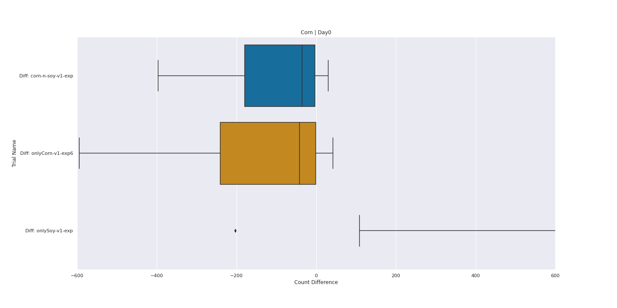

Slide 6
CORN – DAY5 - Overall

Slide 7
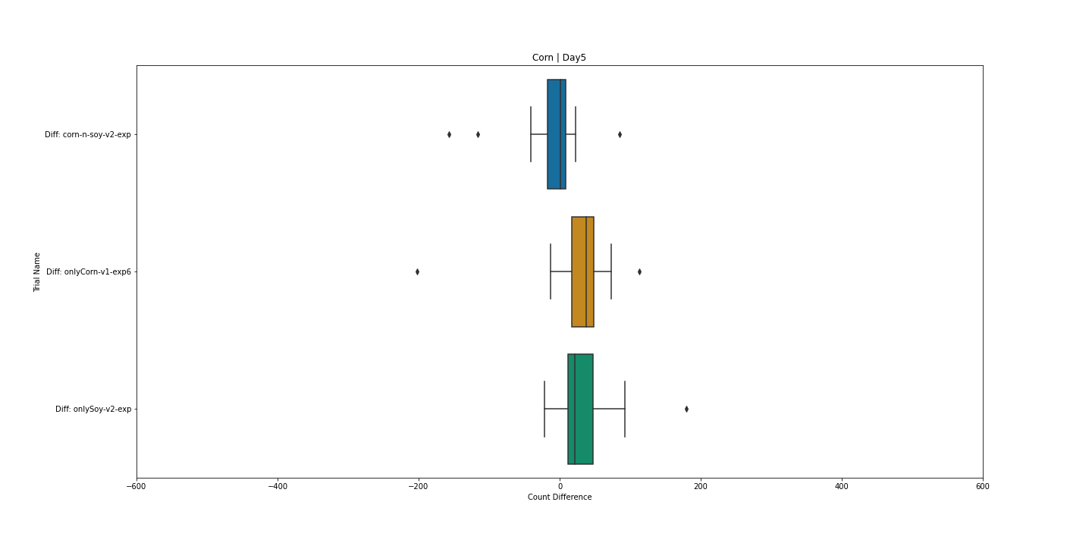

Slide 8
SOY – DAY0 - Overall

Slide 9
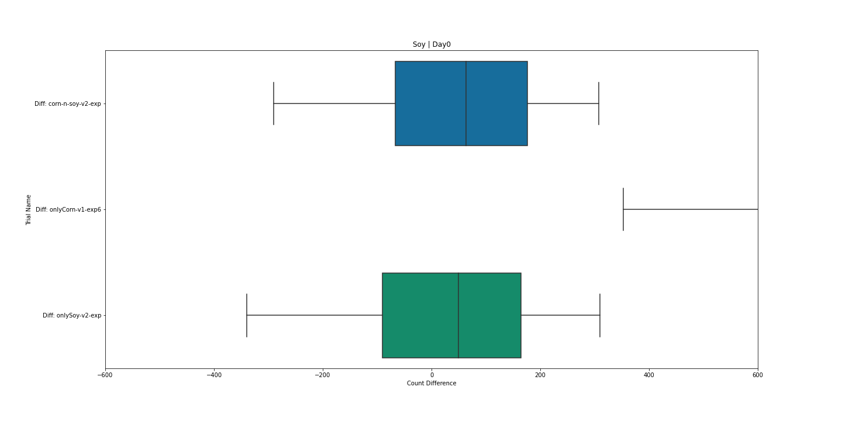

Slide 10
CORN – DAY0 - SIZE

Slide 11
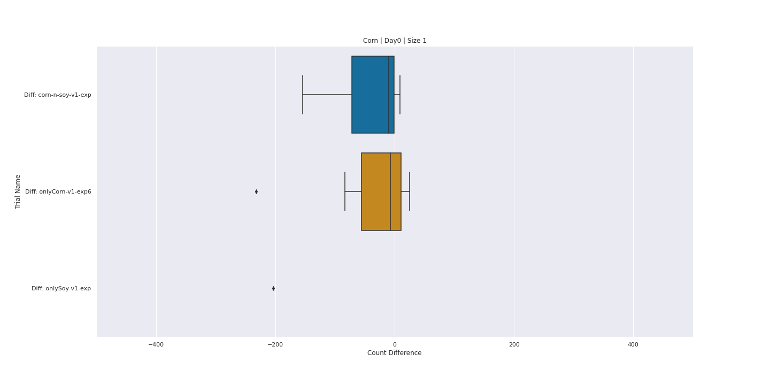

Slide 12
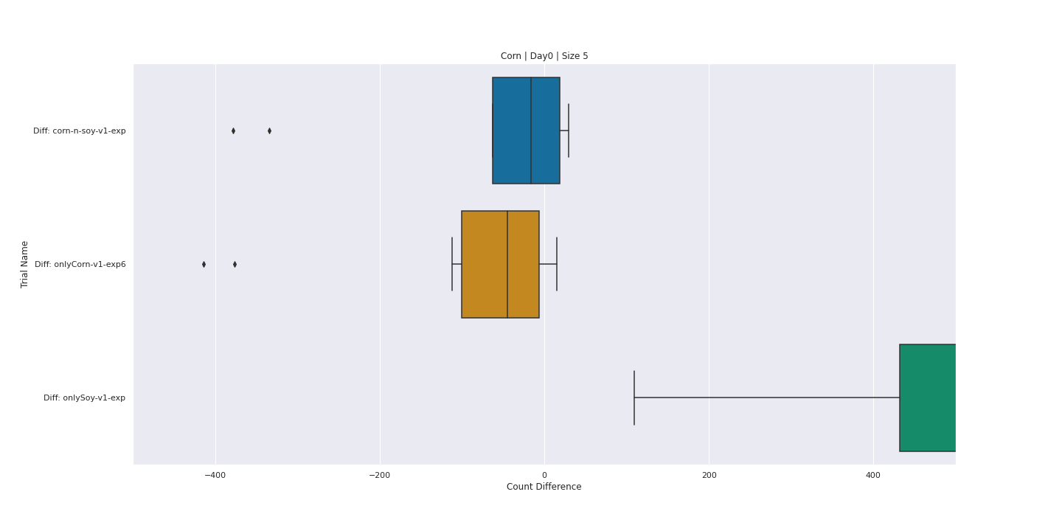

Slide 13
SOY – DAY0 - SIZE

Slide 14
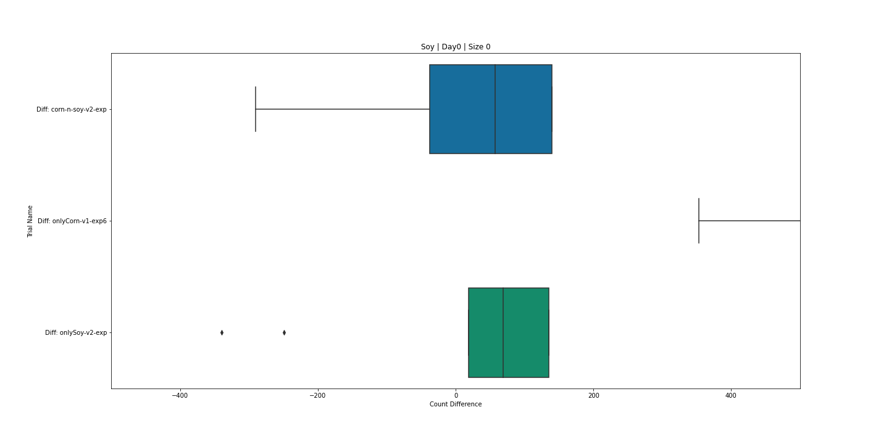

Slide 15
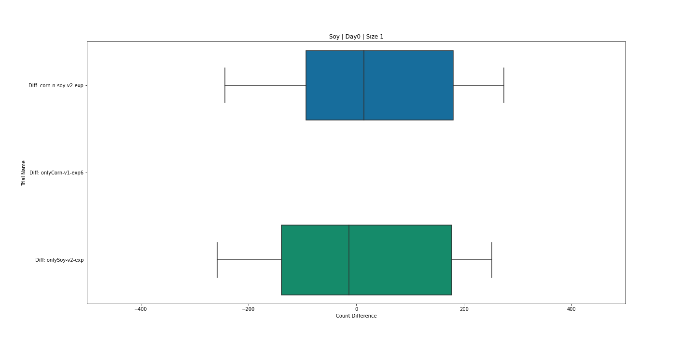

Slide 16
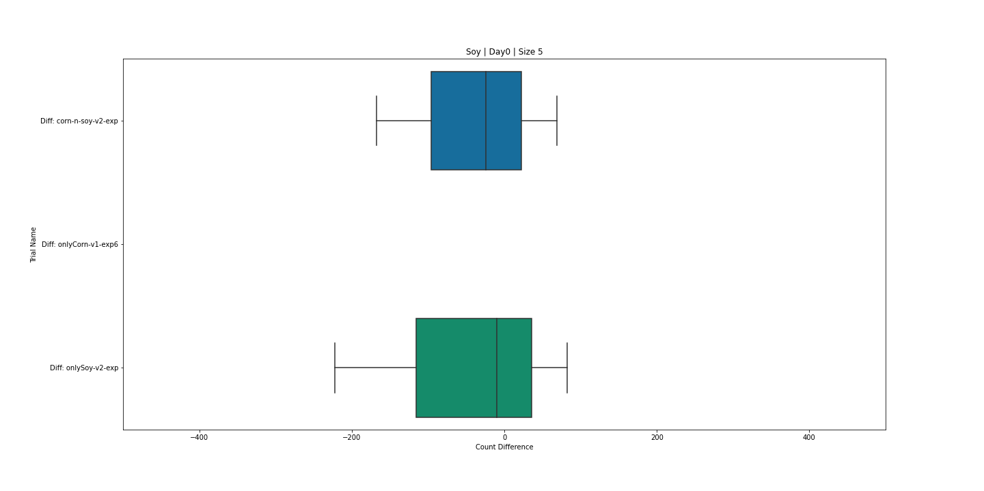

Slide 17
CORN – DAY0 – GROWTH STAGE

Slide 18
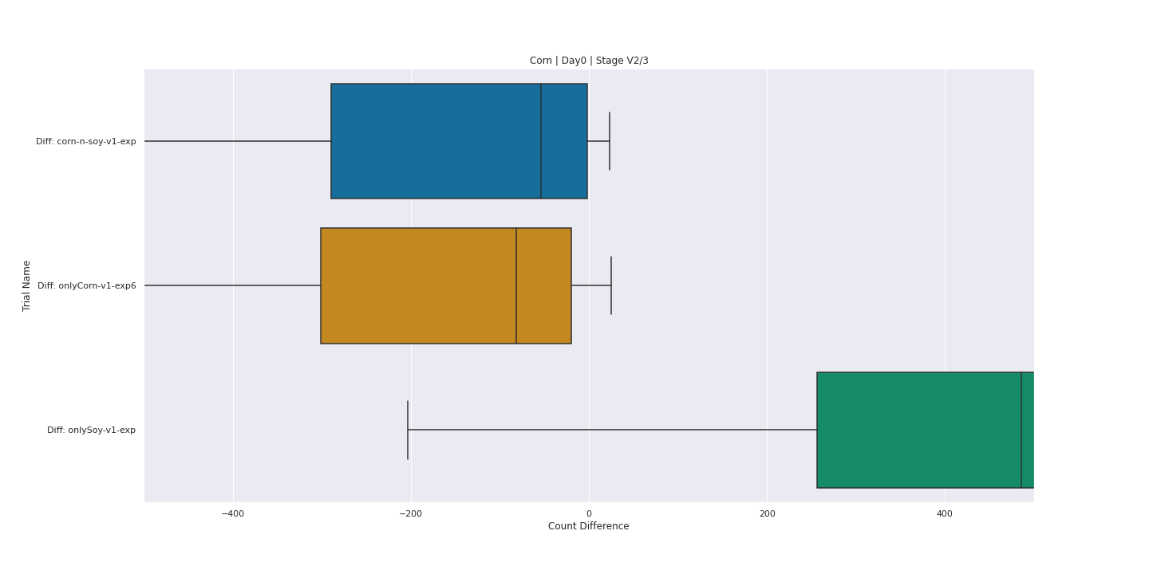

Slide 19
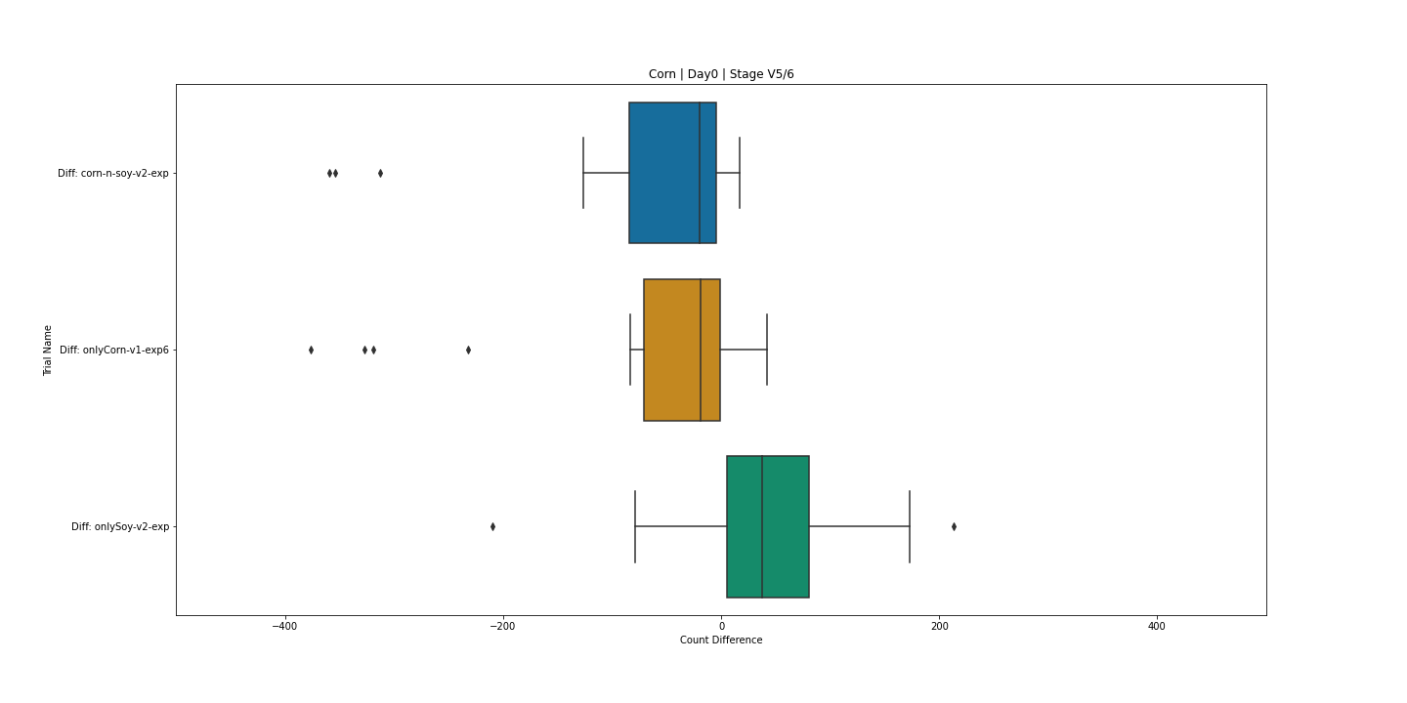

Slide 20
SOY – DAY0 – GROWTH STAGE

Slide 21
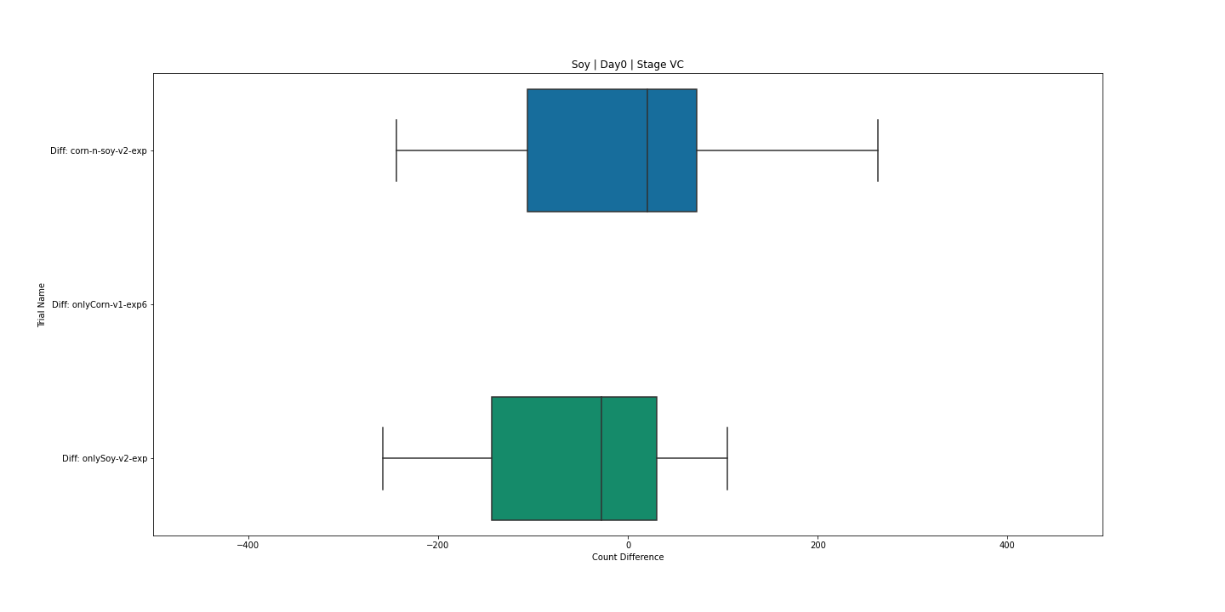

Slide 22
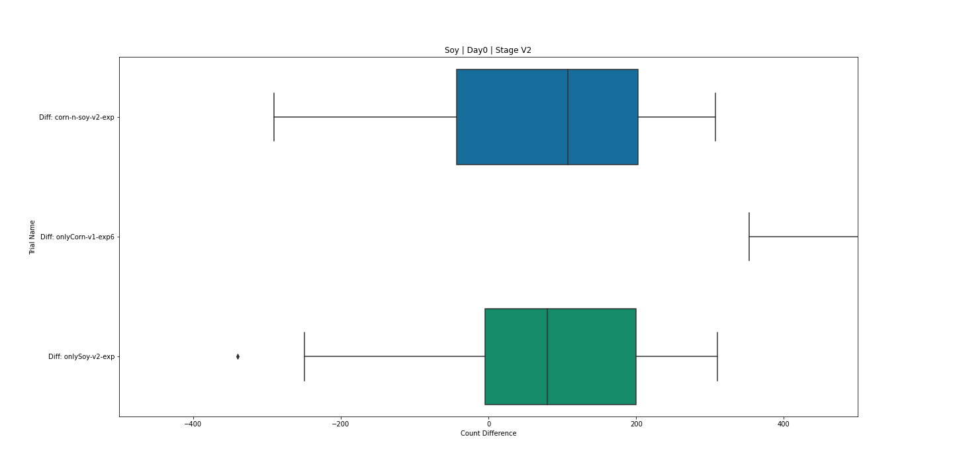

Slide 23
Detection Images

Slide 24
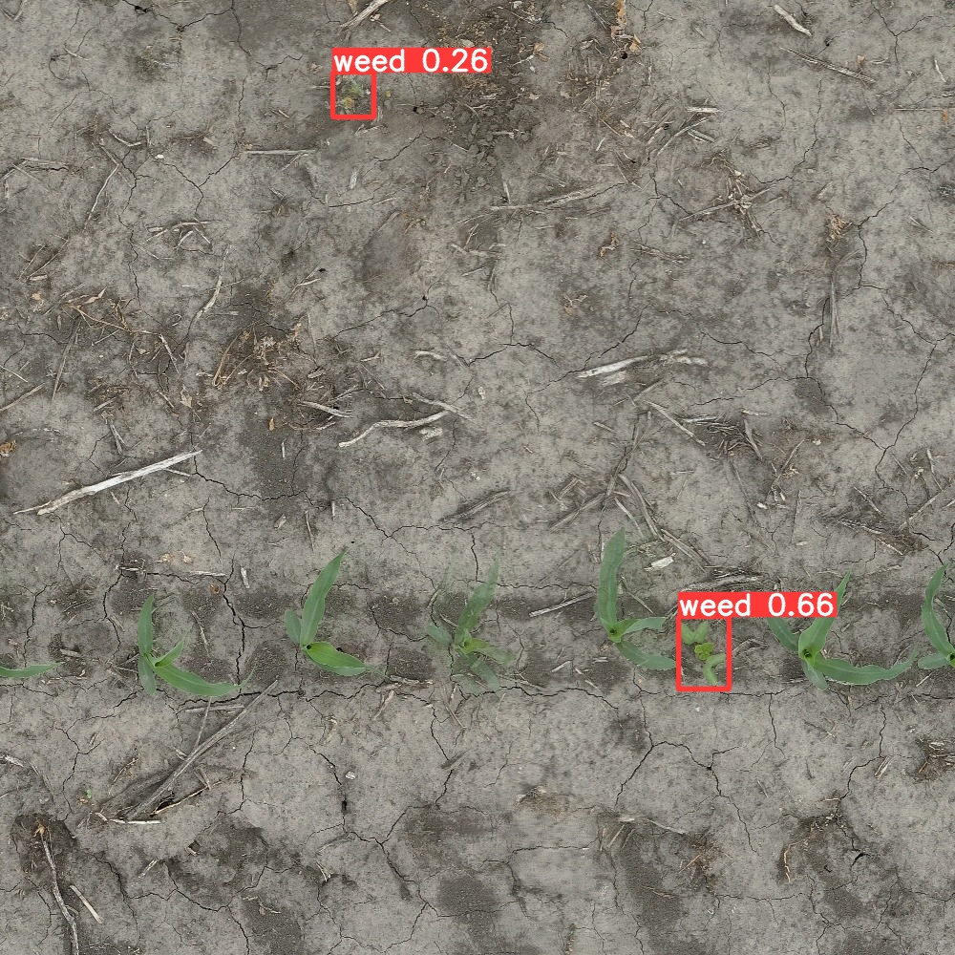
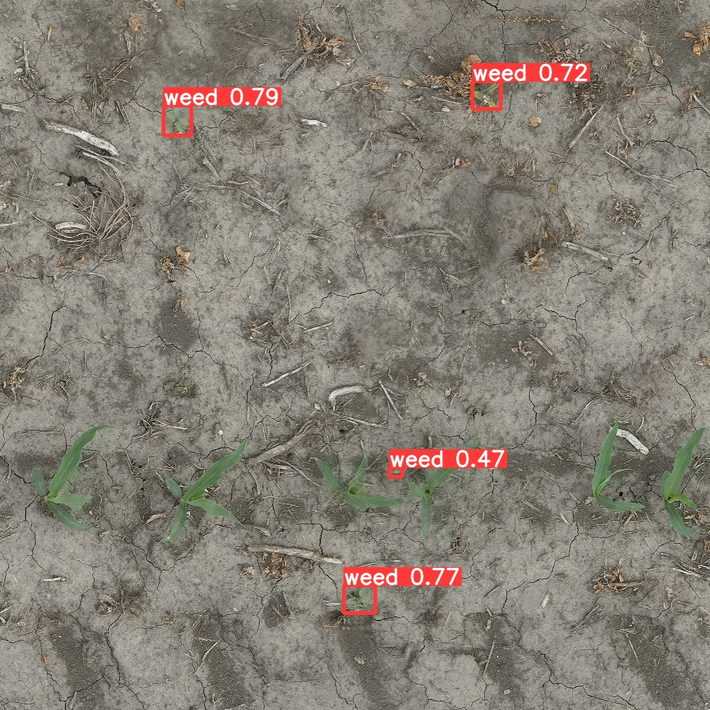
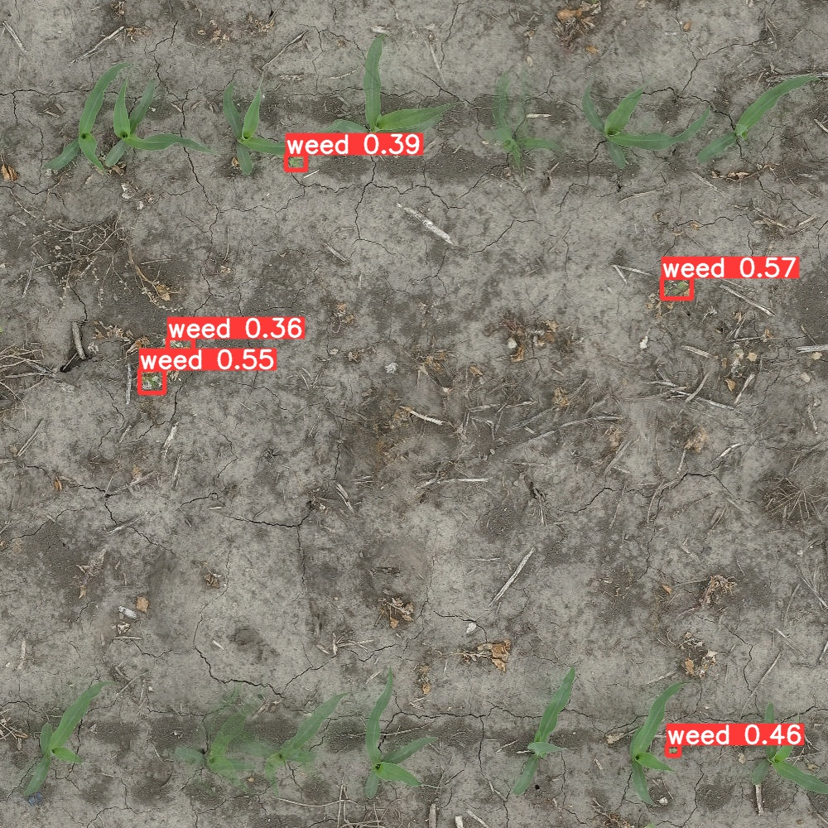
In-row weed detection

Slide 25
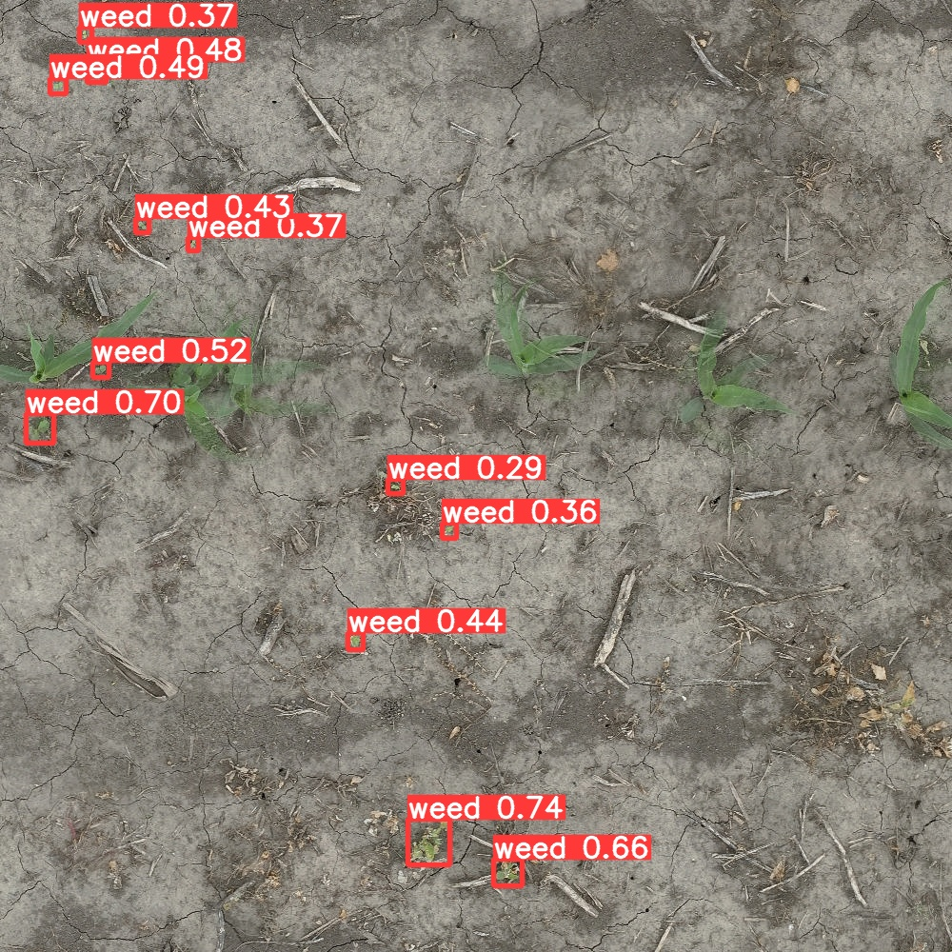
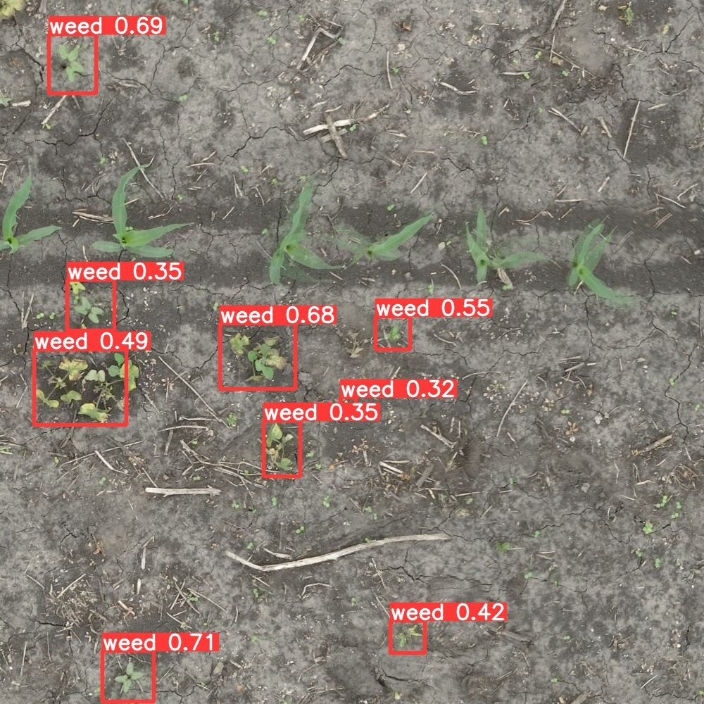
Detection in varying weed size

Slide 26
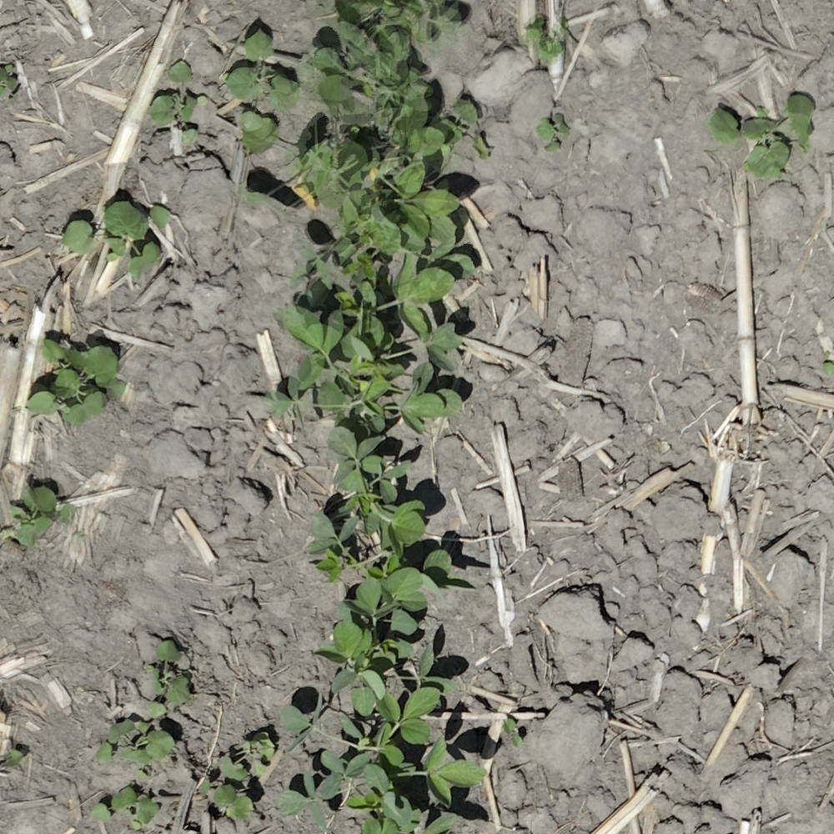
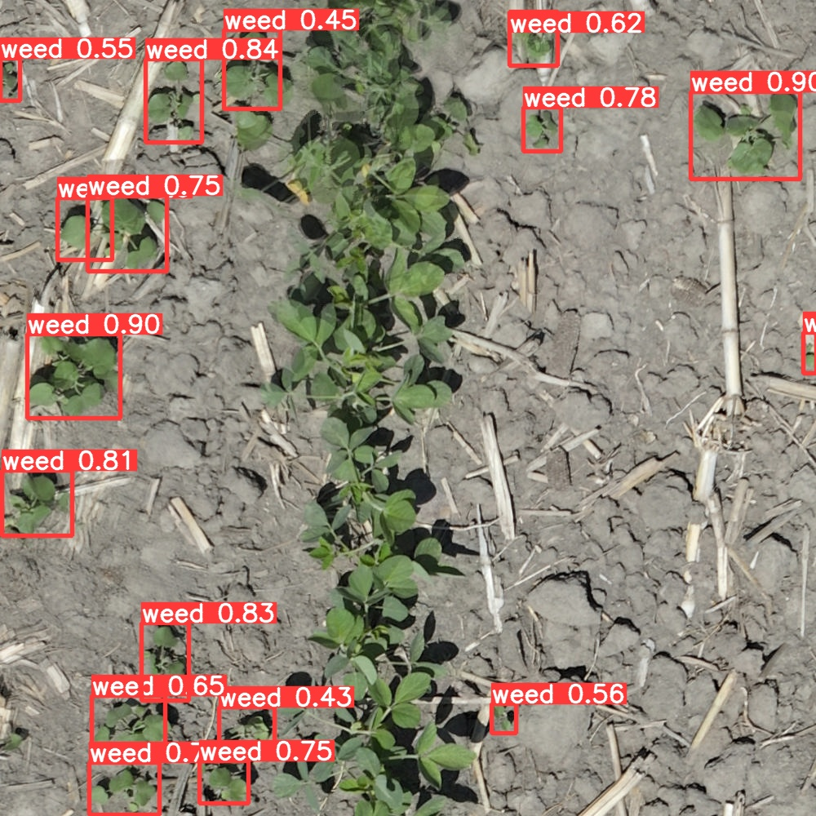
High Density Areas in Soy
17 Weed instances

Slide 27
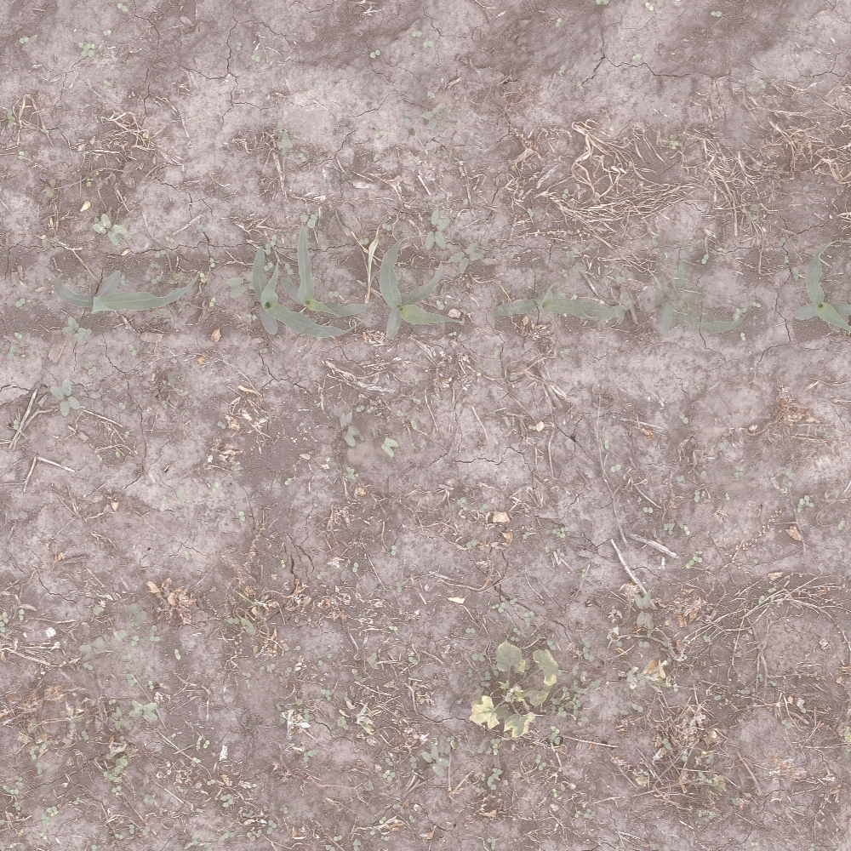
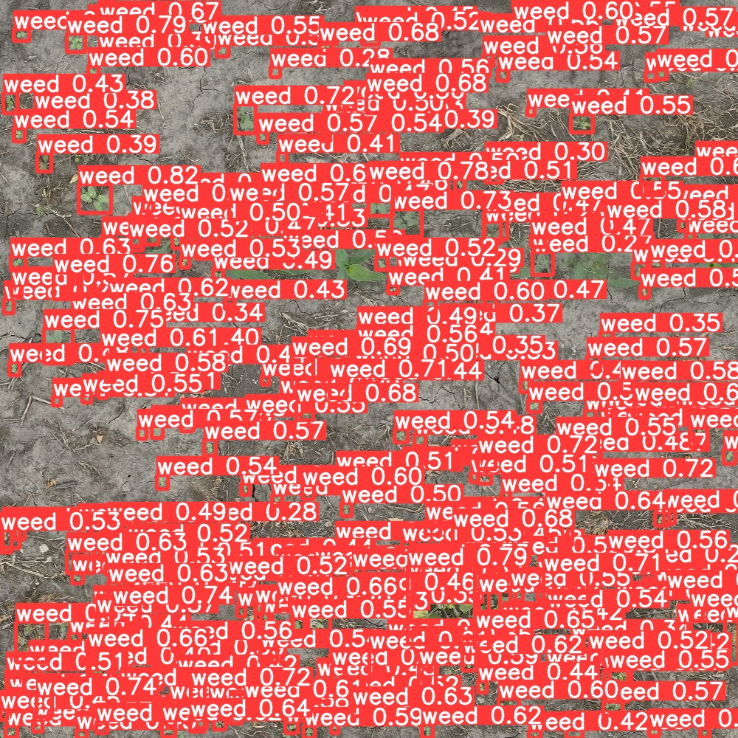
High Density Areas in Corn
204 Weed instances

Slide 28
False Positives and Negatives

Slide 29
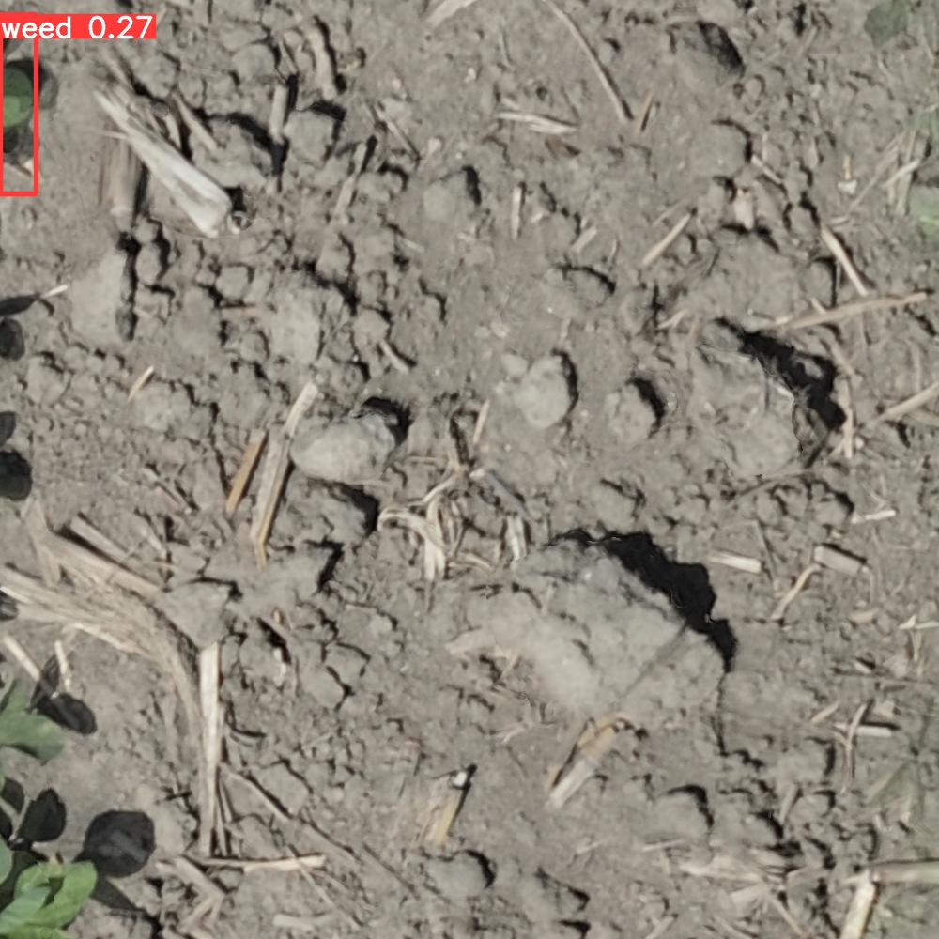
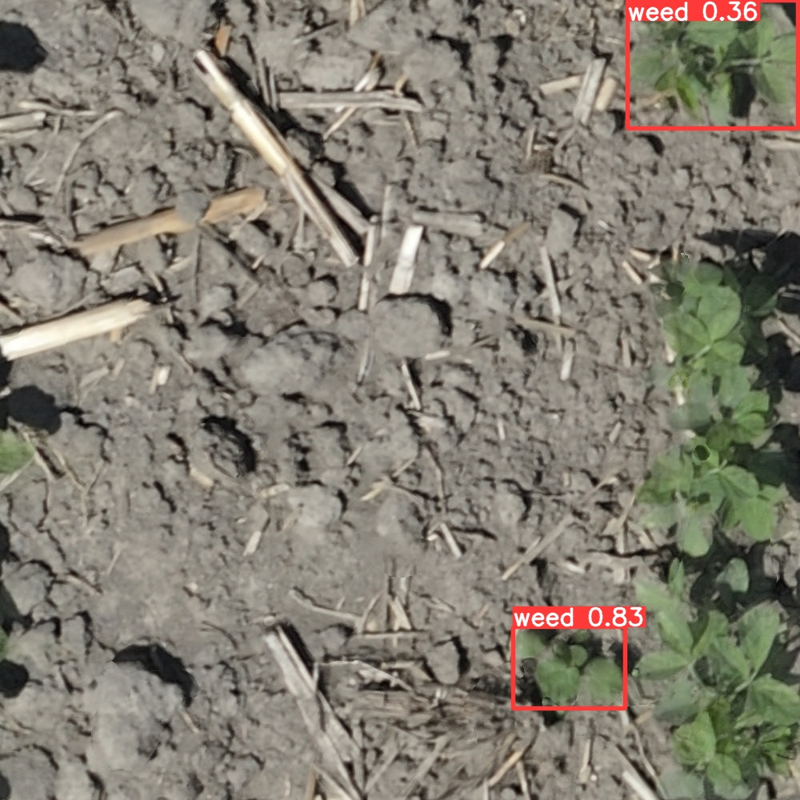

Slide 30
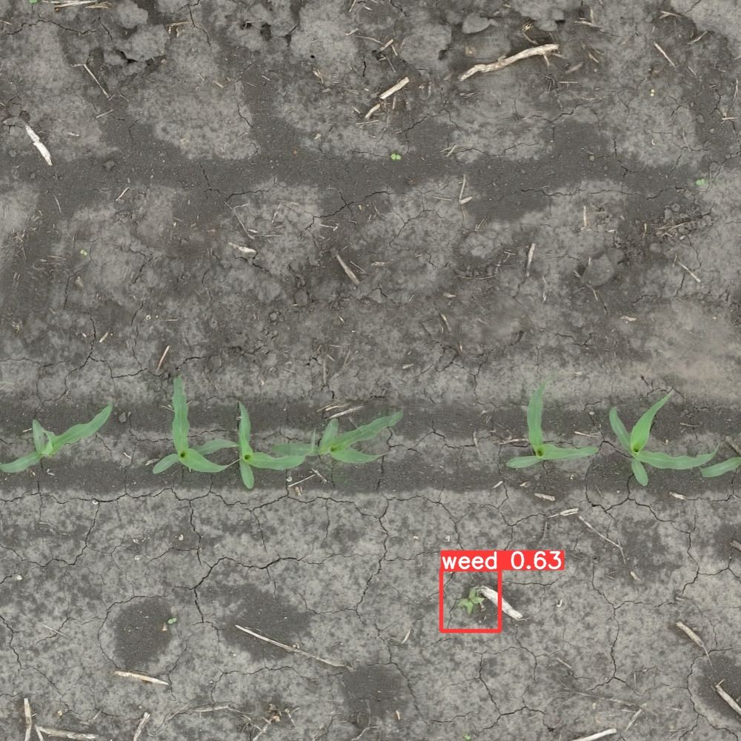
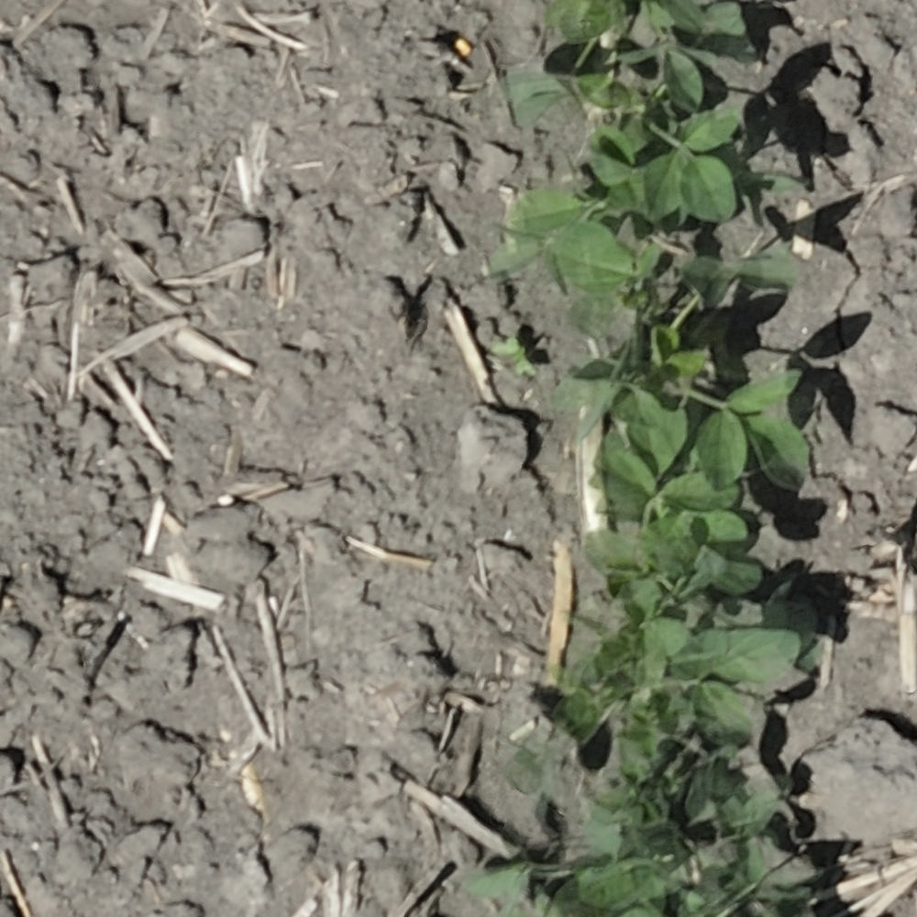

Slide 31
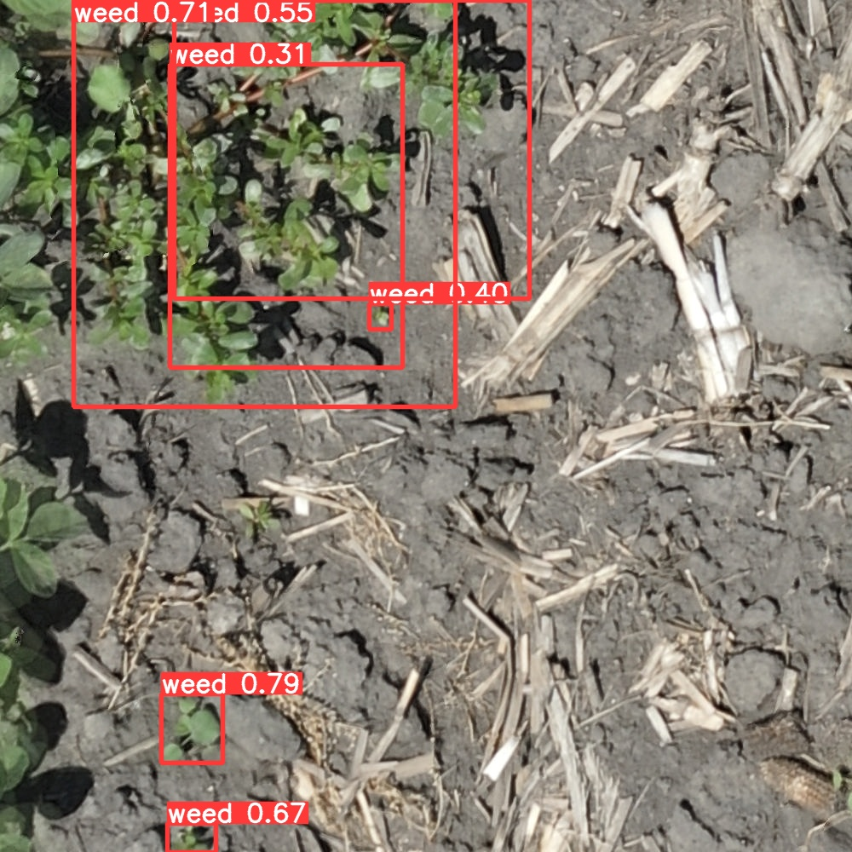

Slide 32
Training Process

Slide 33
Training Data
Ensure unbiased training data
Growth Stage Bias
Weed Size Bias
Weed Species Bias
Setting right training parameters
Validating weed labeling

Slide 34
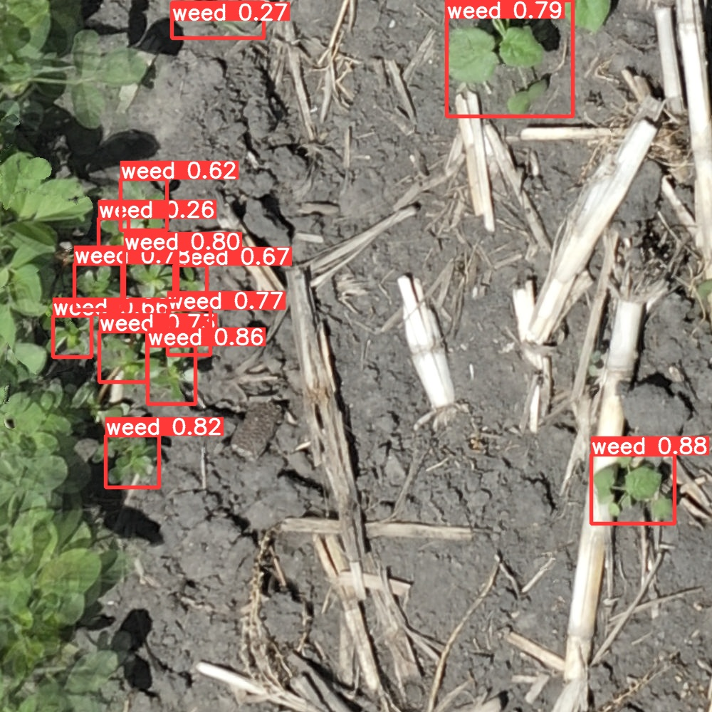
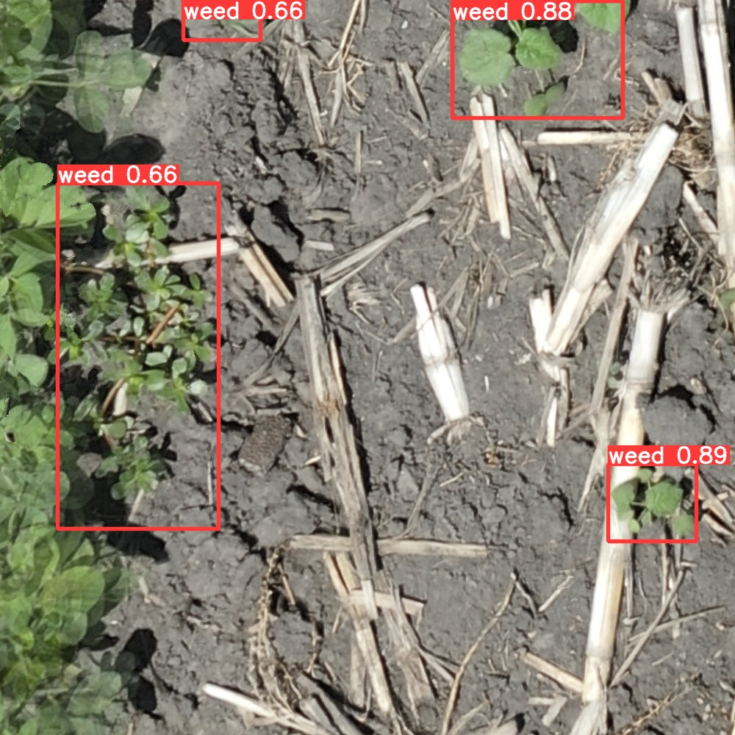

Slide 35
Other Observations
In high weed density area, aerial count could be more reliable than manual count
Soy Plot 105
Manual Count = 89
Aerial Count = 291
Detection Count = 301
Corn Plot 105
Manual Count = 1359
Aerial Count = 1911
Detection Count = 2349

Slide 36
Thank You
Varun Aggarwal
aggarw82@purdue.edu

Slide 37
Plot Number | Treatment | Corn Stage | Size | Manual Count | Number of Training Images | Number of Weeds
101 | 1 | V2/3 | 1 | 176 | 87 | 118
102 | 6 | V5/6 | 5 | 95 | 43 | 54
103 | 3 | V2/3 |  | 627 | 72 | 96
104 | 4 | V2/3 |  | 444 | 9 | 15
105 | 2 | V2/3 | 1 | 1359 | 202 | 1911
106 | 1 | V2/3 | 5 | 838 | 5 | 5
107 | 4 | V2/3 |  | 642 | 2 | 2
204 | 8 | V5/6 |  | 383 | 4 | 4
205 | 7 | V5/6 |  | 431 | 1 | 1
206 | 12 | V5/6 |  | 341 | 13 | 15
208 | 4 | V2/3 |  | 52 | 2 | 2
209 | 5 | V5/6 | 1 | 88 | 14 | 17
210 | 2 | V2/3 | 5 | 419 | 2 | 2
211 | 3 | V2/3 |  | 314 | 3 | 4

Slide 38
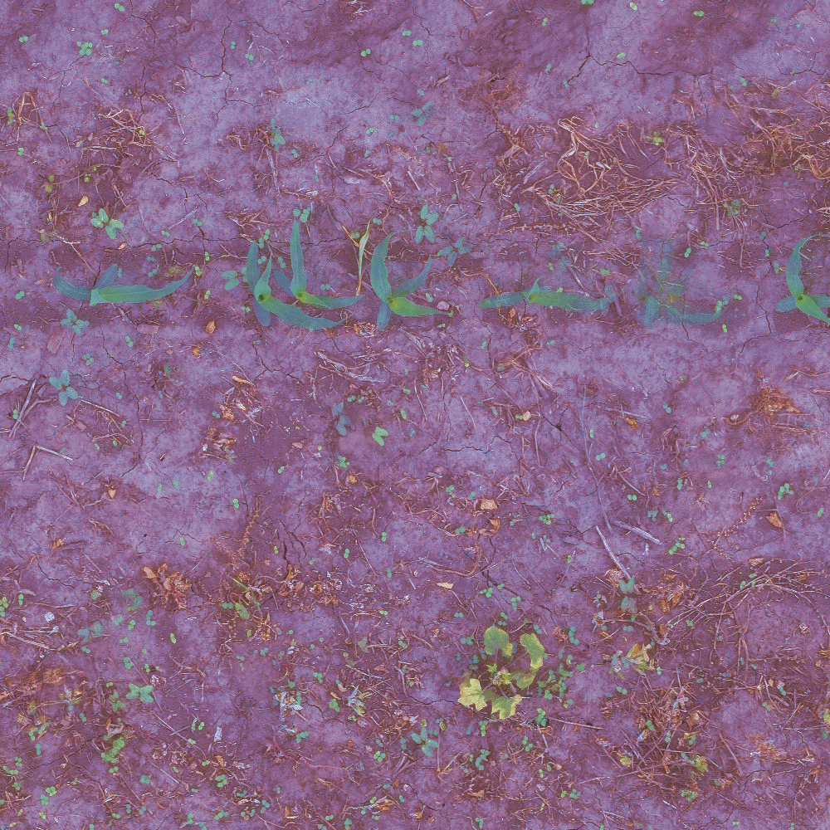
Original
Enhanced

Slide 39
TRAINING DATA STATS SOY

Slide 40
Plot Number | Treatment | Soy Stage | Size | Manual Count | Number of Training Images | Number of Weeds
301 | 10 | V2 | 0 | 894 | 530 | 1689
308 | 8 | V2 |  | 187 | 66 | 87

Slide 41
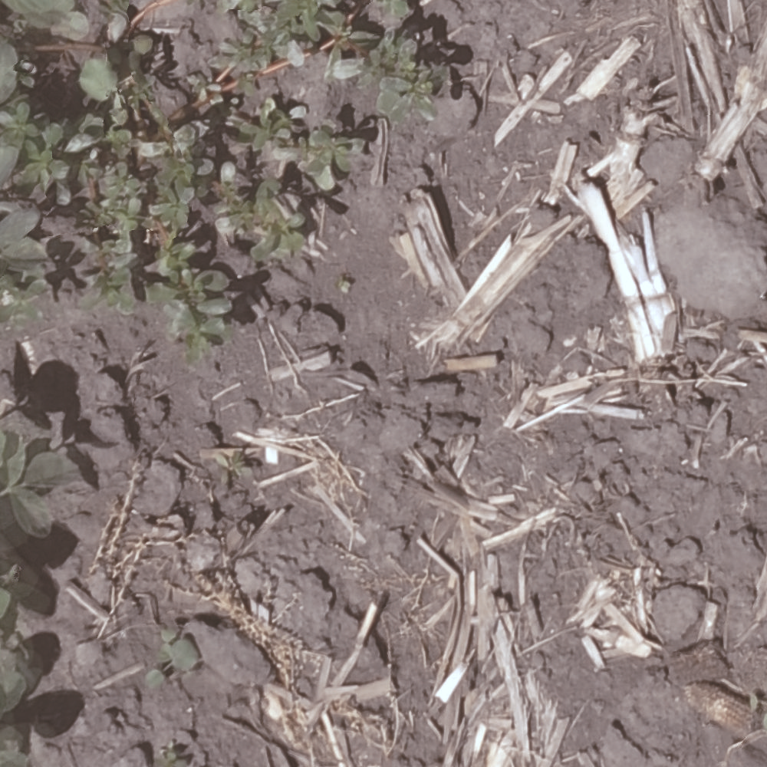
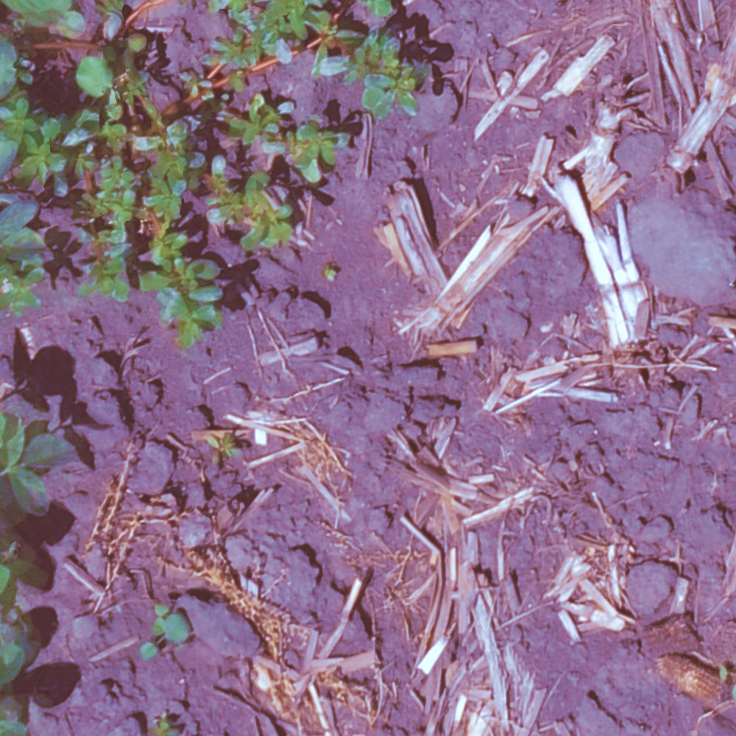
Original
Enhanced

Slide 42
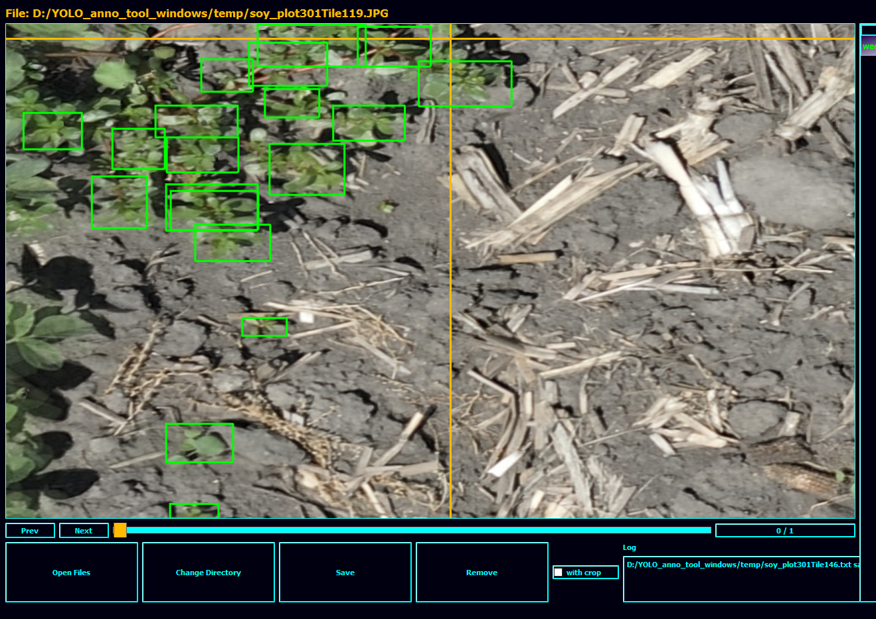
19 Weed instances

